Slide 1



Presentation
On
Emotion Detection using Machine Learning
Bachelor of Technology
In
Information Technology
Dr. A.P.J. Abdul Kalam Technical University , Lucknow (Uttar Pradesh)
Group Member’s
Under the Supervision
Rajeev Kumar
(Asst.Professor)
Roll Number | Student Name | Role & Responsibilities
2001330130019 | Amar Kumar Dubey
2001330130057 | Daksh Singh
2001330130057 | Devansh Pandey

Slide 2
Content
Table of Content
1. Project Title
2. Introduction
  Problem Definition.
  Objectives
  Feasibility Study, Need and Significance.
3. Literature Survey
  Existing Theoretical and Methodological contributions to the proposed work.
  Proposed Methodology in brief

Slide 3
Emotion Detection using Machine Learning

Slide 4
Introduction
Emotion detection with machine learning is about teaching computers to understand human feelings. First, we gather lots of examples of emotions from things like text, speech, and faces. Then, we use special techniques to help computers learn from these examples, like looking at the words people use or the way their faces look.
Facial expressions serve as a rich source of emotional information, conveying nuanced cues through muscle movements and facial configurations. Computer vision algorithms are utilized to analyze facial images and detect key facial landmarks, such as eye movements, eyebrow positions, and mouth shapes. These visual cues are then used to infer the underlying emotional states exhibited by individuals.

Slide 5
Problem Definition
Existing emotion detection systems often struggle to provide accurate and nuanced insights into human emotions. The limitations stem from the reliance on traditional features and modalities, such as text analysis or facial expression recognition alone, restricting the system's ability to capture the complexity of emotional states comprehensively.
The static nature of these systems limits their adaptability to real-time emotional cues, leading to delayed or inaccurate responses in dynamic environments. Moreover, the lack of multimodal integration hampers the system's capability to contextualize emotions across different input sources, such as text, speech, and facial expressions.
Realtime Computer Vision An Interactive Smart Board Platform

Slide 6
Objectives
Assess Feasibility: The primary objective is to evaluate the feasibility of developing an emotion detection system using machine learning techniques. This involves assessing the technical, financial, and operational feasibility to determine if the project is viable and achievable within the available resources and constraints.
Identify Need: The objective is to identify and articulate the compelling need for emotion detection technology in various domains such as human-computer interaction, mental health monitoring, customer service optimization, and educational enhancement. Understanding the need helps justify the investment in developing emotion detection systems and informs decision-making processes.
Recognize Significance: The objective is to recognize and highlight the significance of emotion detection technology in improving user experiences, enhancing decision-making processes, contributing to societal well-being, and fostering innovation and competitiveness. Recognizing the significance helps create awareness and garner support for the development and adoption of emotion detection systems.

Slide 7
Feasibility Study, Need and Significance.
Technical Feasibility: Evaluate the availability of machine learning algorithms, tools, and resources required for emotion detection. Assess the feasibility of implementing complex algorithms and processing large datasets efficiently.
Financial Feasibility: Estimate the costs associated with acquiring hardware, software, and expertise for developing and deploying an emotion detection system. Determine the return on investment and budget required for the project.
Operational Feasibility: Analyze the practicality and ease of integrating emotion detection into existing systems or workflows. Consider factors such as user acceptance, scalability, and compatibility with existing infrastructure.

Slide 8
Need and Significance.
Need:
  Enhanced Human-Computer Interaction: Emotion detection using machine learning can improve human-computer interaction by enabling systems to understand and respond to users' emotional states, leading to more personalized and engaging experiences.
  Mental Health Monitoring: Emotion detection systems can assist in early detection and intervention of mental health issues by analyzing patterns in speech, text, or facial expressions, thereby improving access to timely support and treatment.
Significance:
  Improved User Experience: Emotion detection systems can enhance user experiences by enabling more empathetic and responsive interactions with technology, leading to higher user satisfaction and engagement.
  Enhanced Decision Making: By providing insights into human emotions, machine learning-based emotion detection systems can inform decision-making processes in various domains, such as marketing, healthcare, and education.
  Social Impact: Emotion detection technology has the potential to contribute to societal well-being by improving mental health care, fostering empathy and understanding, and promoting inclusivity and diversity.
  Innovation and Competitiveness: Organizations that invest in emotion detection research and development can gain a competitive advantage by offering innovative products and services that meet the evolving needs and expectations of users.

Slide 9
What is Emotion Detection?
Emotion recognition is one of the many facial recognition technologies that have developed and grown through the years. Currently, facial emotion recognition software is used to allow a certain program to examine and process the expressions on a human’s face. Using advanced image dispensation, this software functions like a human brain that makes it capable of recognizing emotions too.
It is AI or “Artificial Intelligence” that detects and studies different facial expressions to use them with additional information presented to them. This is useful for a variety of purposes, including investigations and interviews, and allows authorities to detect the emotions of a person with just the use of technology.

Slide 10
Importance of Emotion Detection
Understanding Human Behavior: Emotion detection allows computers to interpret and respond to human emotions, enabling better understanding of user needs and preferences in interactions with technology.
Improving Mental Health: Emotion detection can assist in early detection of mental health issues by analyzing patterns in speech, text, or facial expressions, thus enabling timely intervention and support.
Empowering Healthcare: In healthcare, emotion detection can aid in patient monitoring and assessment, enabling healthcare providers to better understand patients' emotional well-being and adjust treatment plans accordingly.
Enabling Adaptive Technology: Emotion detection enables technology to adapt dynamically to users' emotional states, offering personalized recommendations, assistance, or interventions as needed.

Slide 11
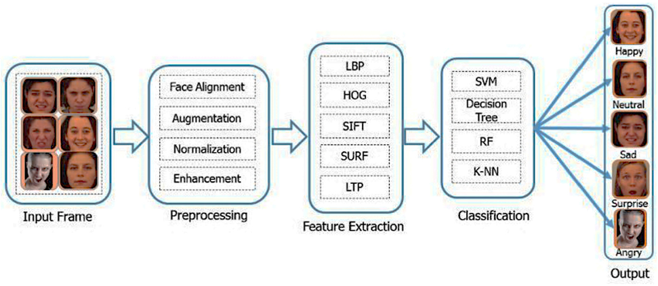
Machine Learning Techniques - Overview
Supervised Learning, Unsupervised Learning, Semi-Supervised Learning

Slide 12
Supervised Learning
Supervised learning is a category of machine learning that uses labeled datasets to train algorithms to predict outcomes and recognize patterns. Unlike unsupervised learning, supervised learning algorithms are given labeled training to learn the relationship between the input and the outputs.

Slide 13
Unsupervised Learning
Unsupervised learning, also known as unsupervised machine learning, uses machine learning algorithms to analyze and cluster unlabeled datasets. These algorithms discover hidden patterns or data groupings without the need for human intervention.
Its ability to discover similarities and differences in information make it the ideal solution for exploratory data analysis, cross-selling strategies, customer segmentation, and image recognition.

Slide 14
Semi-Supervised Learning
Semi-supervised learning is a type of machine learning that falls in between supervised and unsupervised learning. It is a method that uses a small amount of labeled data and a large amount of unlabeled data to train a model. The goal of semi-supervised learning is to learn a function that can accurately predict the output variable based on the input variables, similar to supervised learning. However, unlike supervised learning, the algorithm is trained on a dataset that contains both labeled and unlabeled data.

Slide 15
Challenges
Bias and Fairness: Emotion detection models may exhibit bias or unfairness due to skewed training data, cultural stereotypes, or algorithmic biases. Ensuring fairness and mitigating biases in emotion detection systems is crucial to avoid perpetuating societal inequalities and discrimination.
Data Quality and Quantity: Obtaining high-quality, labeled datasets for training emotion detection models can be challenging due to the subjective nature of emotion labeling and the need for large-scale, diverse datasets to capture the variability of emotional expressions.
Cross-Modal Integration: Integrating information from multiple modalities (text, speech, facial expressions, physiological signals) poses a challenge due to differences in data formats, feature representations, and temporal dynamics, requiring sophisticated fusion techniques and model architectures.

Slide 16
Future Scope
Multimodal Emotion Recognition: Future research will focus on integrating multiple modalities such as text, speech, facial expressions, and physiological signals for more comprehensive emotion detection systems.
Real-time Emotion Recognition: Future systems will prioritize real-time emotion recognition for applications in human-computer interaction, virtual reality, and augmented reality, enabling more responsive and adaptive user experiences.
Personalized Emotion Detection: Emotion detection systems will become more personalized, taking into account individual differences in emotional expression and adapting their responses accordingly for improved user engagement and satisfaction.

Slide 17
Conclusion
Machine learning helps computers understand emotions from text, speech, and facial expressions.
Challenges like subjectivity and data quality exist, but ongoing research in deep learning and context-aware modeling is making progress.
Emotion detection will keep improving human-computer interactions and personalizing experiences.
Collaboration, ethics, and responsible AI development are crucial for harnessing emotion detection's potential.
Ultimately, emotion detection technology aims to create more empathetic, responsive, and inclusive systems for everyone's benefit.

Slide 18
Thank You
Any questions?

